Slide 1
John Pierpont Morgan
By Tesring Dadul, Jose Rivas, Tasin Islam, Karisma Karim, and Abhit Pal

Slide 2
Biography of J.P. Morgan
JP Morgan was born on April 17, 1837 in Hartford, Connecticut and was a financer, art collector, banker, and a philanthropist. He is most known financially for the formation of the United States Steel Cooperation and General Electric. Morgan helped America and society several times from going from a prosperous country to a country having a possible depression such as in the Panic of 1897 and Panic of 1893 and the list goes on. JP Morgan died on March 31, 1913 at the age of 75 in Rome, Italy.

Slide 3
How he donated his money
J. P. Morgan donated his money several times in his life. He donated first to William McKinley who was a candidate for presidency during the 1900's. He then donated to various schools, charities, and organizations. And lastly, he also donated many valuable collections to the Metropolitan Museum of Art.

Slide 4
How he acquired his wealth
John Piermont Morgan’s father was a wealthy man and also a banker. Morgan worked for his father. He started his own banking company in 1871, which later became known as JP Morgan & Co. His company became one of the leading financial firm in the country. He financed the railroad business when building the transcontinental railroad. Even U.S. government was financed by him to help with the depression of 1895 and also during the 1907 financial crisis.

Slide 5
How he (or his related industries) treated his workers.
Industrialist J.P. Morgan and his son were known to be very paternalistic towards his worker. In fact, when Mr. Morgan passed away, his employees were given a years salary.

Slide 6
How he spent his money?
John Piermont Morgan spent his money in many ways. He bought distressed businesses and railroad companies. The biggest company he invested in was the U.S steel corporation. At one point, Morgan helped the U.S government by selling government bonds for gold when they were facing the burden of inflation and ended up buying $200,000,000 government bonds with gold.

Slide 7
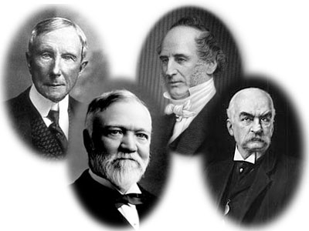
JP Morgan a captain of industry
All robber barons except one

