Slide 1
Aim: What made the Byzantine Empire rich and successful for so long?
Review: What factors led to the downfall of the Western Roman Empire?
Do Now: What elements do you need to build or restore an empire?

Slide 2
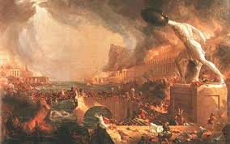
Setting the Scene
German invaders ‘pounded’ the Roman Empire in the west
Rome falls
Empire shifted their base to the eastern Mediterranean

Slide 3
I. Constantine
Started out as a talented general
312 – gained the throne and become emperor
2 Steps:
Tolerated Christianity
Built new capital: Constantinople

Slide 4
Constantine the Great?
Watch the video clip and work with partner to answer the following questions:
1. Do you think that emperor Constantine deserved the title “the great”?
2. How do you rebuild a city?
https://www.youtube.com/watch?v=FEXSD-M6JvI

Slide 5
Constantinople

Slide 6
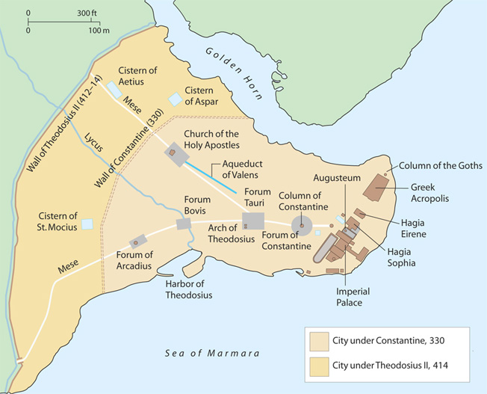

Slide 7
II. Constantinople
Previously known as Byzantium
Ancient Greek city
Geographic Features:
Surrounded by water on 3 sides
Harbors
Fertile land
Positives
Strategic trade
Military Access
Land routes
Negatives
Ability to be attacked by sea
Becomes a prime location

Slide 8
Constantinople
Became the capital and vital center of the empire
Key trade routes linking Europe and Asia
For centuries, it was one of the busiest marketplaces in Europe
Items:
Silks
Wheat
Gems
Spices
Furs
Place of luxury and splendor

Slide 9
III. The Age of Justinian
Ruled 527-565
Wanted to revive ancient Rome
Launched a program to beautify Constantinople
Ruled as an autocrat
Deemed Christ’s co-ruler on Earth

Slide 10
Age of Justinian
Justinian’s Code (Corpus Juris Civilis)
Reformed the law starting in 528
Set up a commission to collect, revise and organize all the laws of ancient Rome
Spread to Western Europe by 1100s
Was used as a model for Roman Catholic Church and medieval monarchs

Slide 11
Justinian Code of Law
“Slaves are in the power of masters, a power derived from the law of nations: for among all nations it may be remarked that masters have the power of life and death over their slaves, and that everything acquired by the slave is acquired for the master.” – Book I, of Persons: VIII. Slaves

Slide 12
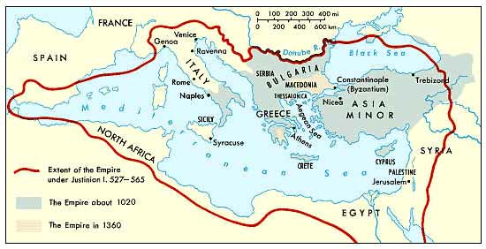
The Byzantine Empire Expands

Slide 13
Byzantine Empire Expands
Byzantine armies reconquered North Africa, Italy, and southern Spain
Done under general Belisarius
Fighting exhausted Justinian’s treasury and weakened his defenses in the east
Temporary victories – in the end Justinian’s successors lost the land

Slide 14
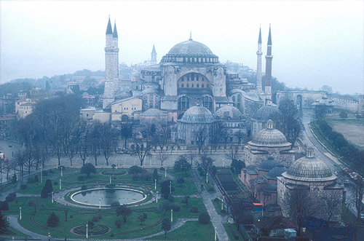

Slide 15
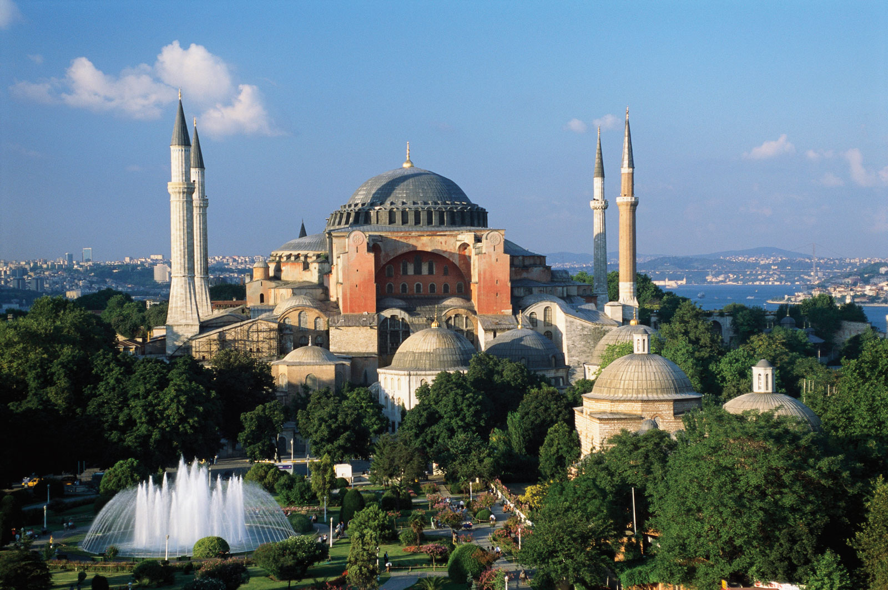

Slide 16
IV. Hagia Sophia
532 – Original Hagia Sophia was destroyed during a revolt
Emperor Justinian rebuilt as brightest jewel of Constantinople
Completed in less than 6 years – 10,000 workers
Largest religious building of its time
After empire fell in 1453 it served as a mosque

Slide 17
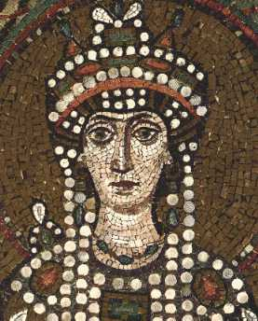
V. Theodora
500-548
Wife, co-ruler and adviser to Justinian
Challenged and tested him
532 – convinced Justinian to remain in Constantinople and crush the revolt

Slide 18
VI. The Nika Riots
January 11-19, AD 532
The most violent riot that Constantinople saw to date
Nika – ‘conquer’
Fires started throughout the city and people were outraged with Justinian

Slide 19
The Nika Riots
Justinian considered fleeing the city but Theodora stopped him
Emperor’s best generals trapped mob inside the Hippodrome
More than 30,000 died
Justinian established his rule and rebuilt city

Slide 20
Class Activity
Work in groups to examine pieces of Art from the Metropolitan Museum of Art
Answer 2 Questions
1. What is the artifact in the picture?
2. What does it tell us about Byzantine and society under Justinian?

Slide 21
Pair of Jeweled Bracelets
500–700
Portrait Bust of a Woman with a Scroll
late 4th–early 5th c.

Slide 22
Solidus of Justinian I
538–565
Fragment of a Floor Mosaic with a Personification of Ktisis
500–550

Slide 23
Let’s Summarize

Slide 24
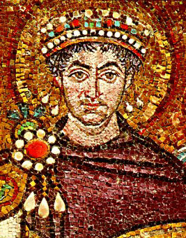
Aim: Why did the Byzantine Empire finally crumble?
Do Now: One thousand years is a long time for a civilization to last. The US is only about 300 years old. Do you think we’ll make it to 1000? What makes an empire last for so long?

Slide 25
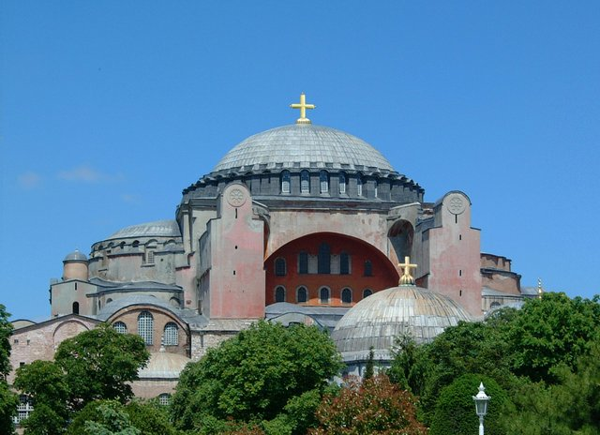
Byzantine Christianity
Setting the Scene:
Christianity was just as influential in the Byzantine Empire as it was in Western Europe.
Notes:
What are the major tenets of Christianity?

Slide 26
Christianity in the Byzantine Empire
Constantine – tolerates Christianity
Theodosius – official religion
Justinian I – Representative of Christ
Second Council of Constantinople (533)
Nothing could be done in the church against the emperors will + command

Slide 27
Divisions Grow
Byzantine Emperor -> not a priest
Controlled Church affairs
Appointed Patriarch = highest church official in the east
Rejected the Popes claims over all Christians

Slide 28
Primary Source Analysis
“I am the Lord your God, who brought you out of the land of Egypt, out of the house of slavery; You shall have no other gods before me. You shall not make for yourself an image, whether in form of anything that is heaven above, or that is on earth beneath, or that is the water underneath. You shall not bow down to them or worship them, for I the Lord your God am a jealous God…”
-Exodus 20:1-5
Ten Commandments
Where did this primary source come from?
Explain in your own words, what this quote means to you?

Slide 29
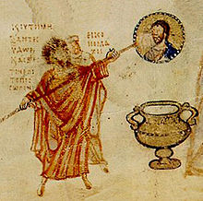
Divisions Grow
Icons –sacred images
Caused a theological debate on the appropriate use of icons
Iconclasm “Image Breaking”
First 726-787
Second 815-843
Iconclast Wars
Notes:
Do icons break the second commandment?
At the time, many Christians prayed to saints or holy people, represented by icons, or paintings of these people. While the emperor of the Byzantine Empire tried to wrestle his people away from icon worship, the leaders of the Roman Church became upset with the Byzantines. Icons were valuable assets in teaching christianity because many people in western europe could not read.

Slide 30
Religious, economic and political divisions –
Supported by Eastern, poorer peoples
Opposed by wealthier people of Constantinople & Italian/Balkan Peninsulas
After 843:
Standardized church decorations = mosaics
Pope takes a hand in the dispute = left resentment against the Pope
First and Second Iconclast Wars
Notes:
Imperial legislation barred the production and use of figural images
Emperor issued, backed by Imperial-appointed leaders & councils of Orthodox Church
In Constantinople, existing icons were destroyed or plastered over
The cross gets promoted as the most acceptable decorative form for Byzantine Churches

Slide 31
The Great Schism
1054
Permanent split into Eastern Orthodox Church and Roman Catholic Church
Notes:
The pope and other church leaders in Rome immediately banished the Byzantine emperor from the Christian church, byzantines felt the pope did not have the authority to banish the emperor.

Slide 32
The Great Schism
Two churches began to divide in 8th c. = gradual split
1054 = permanent split into the Eastern Orthodox Church and Roman Catholic Church
Pope and Patriarch excommunicated each other
From here on out they treat each other as rivals instead of branches of the same faith
Contact is always cold and distant
Notes:
Roman Catholic Church
Pope Leo IX
Believed he was the supreme being of Christianity
Eastern Orthodox Church
Patriarch Michael I
Believed he was “first among equals”

Slide 33
A Shrinking Empire
Great Schism begins decline
Strength was Undermined:
Internal –
Local lords control large areas
External –
Enemies advance
Normans
Seljuk Turks

Slide 34
Notes:
Solid Line to enclose area

Slide 35
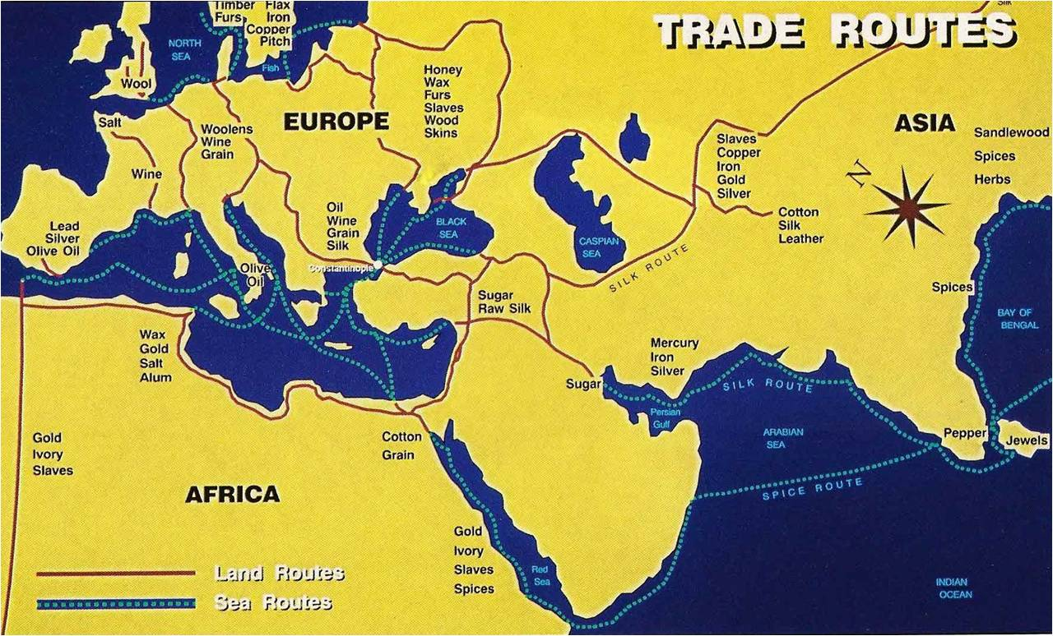
Notes:
Line with arrows

Slide 36
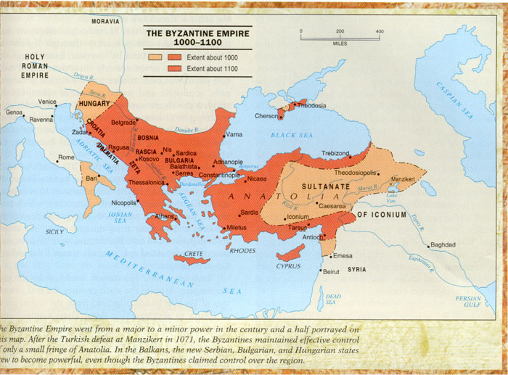
Notes:
Dotted line

Slide 37
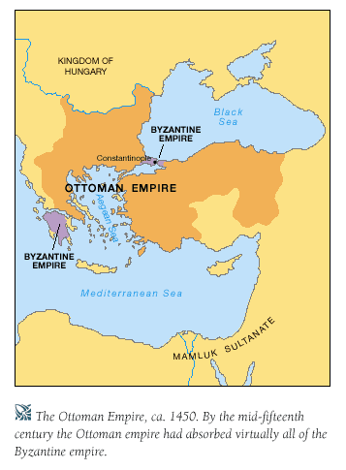
Notes:
Circle spots

Slide 38
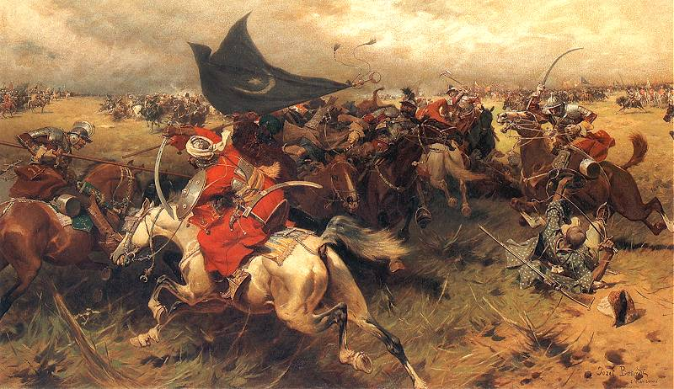
The Ottomans
Muslim-Turkish warriors
Ottoman army =
Kidnapped Christian boys from conquered towns -> converted them to Islam -> trained them to be soldiers
New gunpowder weapons - cannons
Mehmed II
Leader - Ottoman forces

Slide 39
Siege Of Constantinople
1453 =
-Ottoman forces surround Constantinople
-Emperor stays to die
-Constantine XI
Siege lasts 2 months
-Knock down wall

Slide 40
History’s Turning Point
https://www.youtube.com/watch?v=wFUU1hd1XLQ
Discussion Questions:
1. Do you think Constantine XI should have made a deal with Mehmed II?
2. How did the weapons the Ottomans introduce change the world forever?

Slide 41
The Fall of Constantinople
http://www.history.com/shows/mankind-the-story-of-all-of-us/videos/fall-of-constantinople
Discussion Questions:
Was the Fall of Constantinople significant?

Slide 42
Fall of Constantinople The Byzantine Point of View Primary Source Close Reading

Slide 43
Let’s Summarize…

Slide 44
Aim: How did the geography and the migrations of different peoples influence the rise of Russia?
Do Now:
What is Cultural Diffusion? Can you give any examples from the first half of 9th grade Global.

Slide 45
Cultural Diffusion
Spread of ideas, customs, and technologies from one people to another

Slide 46
Setting the scene
Justinian’s reign ends 565
The Great Schism 1054
Fall of Constantinople 1453
Ottoman Empire

Slide 47
Geography of Russia

Slide 48
Geography of Russia
Eurasian plain
3 zones
Northern forests
Fertile middle
Southern steppe
Steppe – open, treeless grassland

Slide 49
Geography of Russia
Rivers
Dnieper
Volga
Rivers linked Russia to the Byzantine empire

Slide 50
Early Russia
“The third Rome…shines like the sun…throughout the whole universe…Two Romes have fallen, and the third one stands, and a fourth one there shall not be.”
-Philotheos, quoted in Tsar and People

Slide 51
Byzantine Influences
Relationship started with trade
Christian missionaries convert Slavs
Constantinople → Kiev
Princess Olga – 957
Vladimir – Rurik dynasty

Slide 52
Primary source analysis
The Russians become Christians
Prince Vladimir of Kiev sent representatives to visit the churches of many lands:
“The envoys reported, ‘When we journeyed among the Bulgars, we beheld how they worship in their temple…Their religion is not good. Then we went among the Germans,…but we beheld no glory there. Then we went on to Greece, and the Greeks led us to the edifices (buildings) where they worship their God, and we knew not whether we were in heaven or on earth. For on earth there is no such splendor or such beauty, and we were at a loss how to describe it. We know only that God dwells there among men, and their service is fairer than the ceremonies of other nations. For we cannot forget that beauty.”
-The Primary Chronicle

Slide 53
Writing Exercise:
In packet, please answer the following question in one paragraph (3-6 sentences).
What impressed the Russians about the Greek Orthodox Church? Why is finding a religion attractive to them?

Slide 54
Byzantine influences
863 –
Adapt Greek alphabet
2 Greek monks
1. Cyril
2. Methodius
Cyrillic alphabet
Written script

Slide 55
Cyril and Methodius
How does this image reflect the contributions of Cyril and Methodius?

Slide 56
Graphic Organizer
Varangians
Byzantines
Mongols
Slavs

Slide 57
EARLY RUSSIANS
The Slavs
Southern Russia
During Roman times
Simple political organization
Clans

Slide 58
early russians
The Varangians
700s & 800s
Vikings
Scandinavia
Expert sailors
Integrated with the Slavs
Absorbed into culture

Slide 59
The varangian rus
Work with partner to make a answer the following questions from the video clip:
1. What were the arguments made for the Vikings being the true founders of Russia?
2. Why do people today think of Vikings as wild, savage people who were always fighting and raiding?
https://www.youtube.com/watch?v=X4_r-IySNKM

Slide 60
Growth of kiev
Yaroslav the “Wise”
1019-1054
Written law code
Golden Age

Slide 61
Decline of kiev
1100s
1. Rival families battled for throne
2. Byzantine fades = Kiev fades
3. Mongol invaders

Slide 62
Mongol conquest
1200s
Genghiz Khan
“World Emperor”
1236-1241
Golden Horde
Tolerance
Russian Orthodox
Church

Slide 63
Mongol impact
Heavy taxes
Serfdom increases
New trade routes
China & Eastern Europe

Slide 64
Mongol Influence
Women
Isolation
Slavery
Absolute Power
Model for later Russian rulers
No contact with Western Europe
Missed advances in arts & sciences

Slide 65
Moscow takes lead
Political + Spiritual center
Russian Orthodox Church capital
Princes of Moscow = defenders against foreigners
1380 – defeated Golden Horde
tsars – Caesar
“The czar – is in nature like all men, but in authority he is like the highest God.”
Boyars – landowning nobles

Slide 66
Russian czars
Ivan III
Known as “the great”
1462-1505
Recovered land
Absolute rule

Slide 67
Russian czars
Ivan IV
Known as “the terrible”
Centralized royal power
Limited boyars/increased nobility
Manor system
1560 – unstable
Oprichniki – agents of terror
Brings Russia to ‘Time of Troubles’

Slide 68
Ivan the terrible

Slide 69
Exit slip
An influence that spread from the Byzantine Empire to Russia was the…
Orthodox Christian Religion
Use of Latin Alphabet
Beginning of democracy
Factory system
In two-three sentences, explain how did the Byzantine Empire influenced early Russia?

Slide 70
AIM: How did geography and ethnic diversity contribute to the turmoil of Eastern European history?
Do Now: What do you know about present day Eastern Europe?

Slide 71
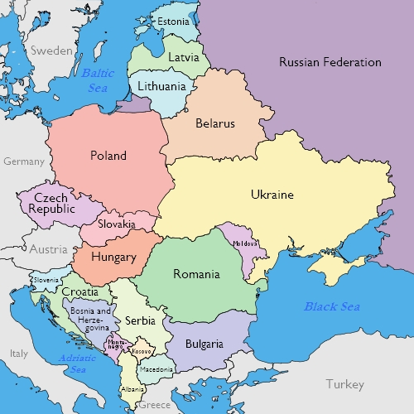

Slide 72
Geography Shapes Eastern Europe
Wide swath of territory between German-speaking Central Europe to the west and the largest Slavic nation, Russia, to the east
Balkan Peninsula: roughly triangular arm of land that juts southward into the warm Mediterranean
River routes create goods and cultural influences

Slide 73
Migrations Contribute to Diversity
Geography contributes to cultural diversity
Ethnic group: a group of people who share the same language and cultural heritage
Christians, Muslims and Jews all influence the region
Jews specifically migrate to Poland

Slide 74
Three Early Kingdoms Develop
Poland
Largest state in Europe
Political power gradually shifted from monarch to nobles
Diet (assembly)
Hungary
Magyars settle in Hungary
Golden Bull of 1222: limits royal power
Serbs
Heavily influenced by Byzantines

Slide 75
Timeline Activity
Three Early Eastern European Kingdoms
Instructions:
Each group will make a timeline from a certain period in Byzantine History using notes and reference materials
Label –
1. Leaders
2. Military Expansion or Shrinkage
3. Economic Developments
4. Social Changes
5. Religion
Write brief analysis (3-6 sentences) of what your overall timeline shows
What you need:
Minimum - 15 events on your timeline
4 leaders (political or religious)
At least 3 religious event
At least 3 political event
At least 2 military event
At least 2 economic event
At least 1 drawing

