Slide 1
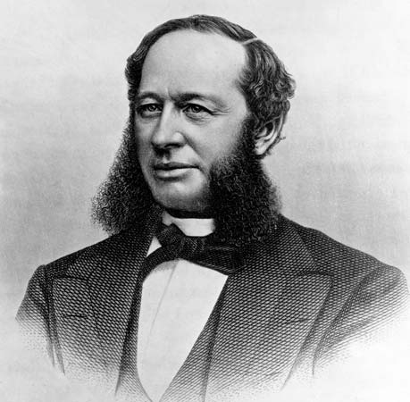
Cornelius Vanderbilt
By Charles, Cecilia, and Daniel

Slide 2
How did he acquire his wealth?
Cornelius Vanderbilt was a self-made multi-millionaire who acquired his wealth in shipping and the railroad and one of the wealthiest Americans of the 19th century. Vanderbilt went into business for himself in the late 1820s, and eventually became one of the country's largest steamship operators. In the 1860s, he built another empire in the railroad industry. When Vanderbilt died, he was worth more than $100 million.

Slide 3
How did he treat his workers?
The reports on Cornelius Vanderbilt suggest he did not treat his employees very well. The employees were hired to work long hours and often did not receive a high amount of compensation for the work. He did give many people jobs who were previously unemployed. He is considered to be one of the richest Americans in the history of the country. He was estimated to have had a net worth of $105 million at the time of his death in the year 1877.

Slide 4
How he spent his money?
Cornelius Vanderbilt repaid his mother and father the 100$ they gave him to start his steamboat career. He bought off smaller companies to take over and create monopolies of railroads and steam boats.

Slide 5
How He Donated His Money?
Cornelius Vanderbilt Cornelius Vanderbilt spent a lot of his money buying stock in the Erie Railway. He also donated $1 million dollars to the now Vanderbilt University and $50,000 dollars on a church. When he died in 1877 he was worth $100 million dollars.

Slide 6
Robber Baron or Captain of Industry
Cornelius Vanderbilt was a captain of industry. He built the railroad system known today as Grand Central Terminal. An incredible amount amount of money went into this project of his. His estate was worth 100 thousand dollars at the time which was extremely uncommon for any estate at that time.

Slide 7
Jay Gould is a Robber Baron because after the Civil War, the U.S. economy was terrible. The government wanted to limit the amount of paper dollars in circulation and put more gold into the economy. Gould (working with Fisk) wanted the government to hold on to its gold, buy it cheaper and sell it when the price goes up. So in order to stop the plan, they used the president’s brother-in-law to get close to the president himself in order thwart the plan.
Henry Ford, another Robber Baron for almost shutting down the automobile company because he did not want to come to terms with the United Automobile Workers.
Andrew Carnegie: He paid his workers very low wages so he could become richer. He helped himself but not his employees. His workers faced many heath hazards and dangerous conditions, and he was corrupt in the government.

Slide 8
John Rockefeller: He took away ALL small businesses of oil and created the Standard Oil Trust, which hurt many people's pay and jobs. He also made secret agreements with people and which is very corrupt.
JP Morgan mislead investors into investing into his company at low risks when in fact they were high risks,
Jim Fisk had a relationship with a prostitute who later left him for one of his business associates.

